Slide 2
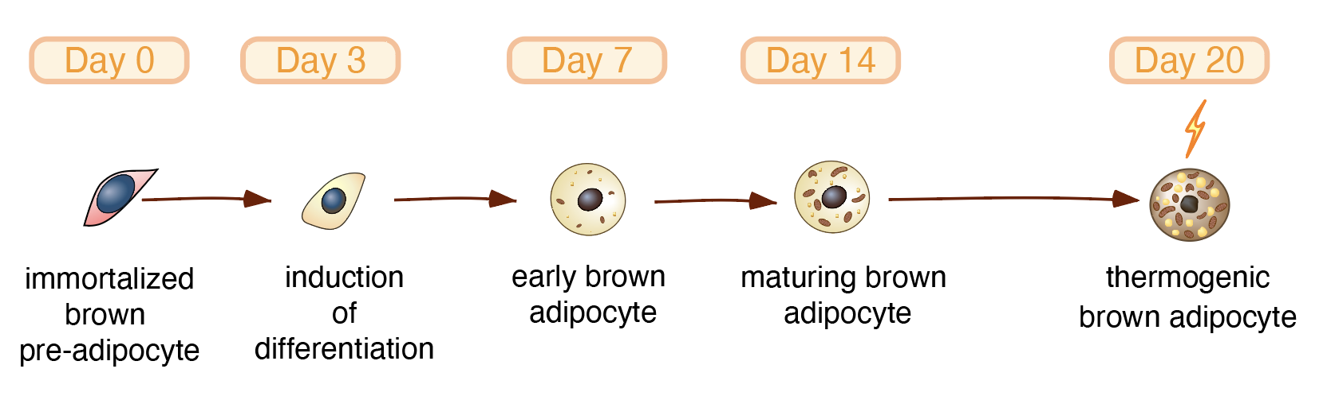
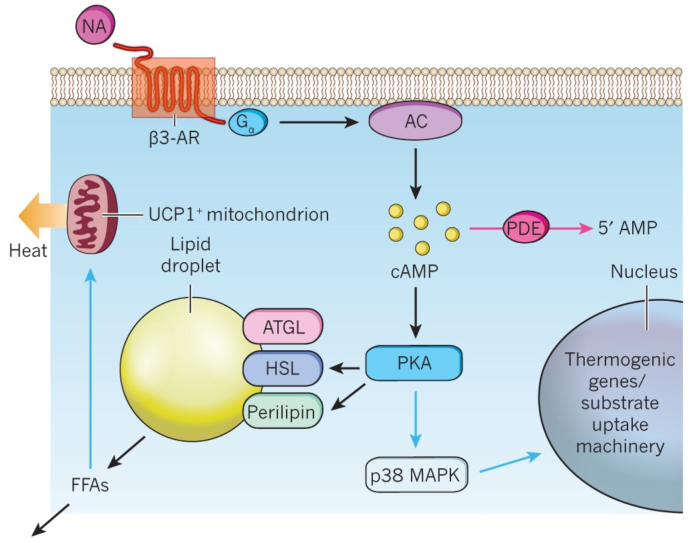
Lipid droplet number: readout of number of differentiating adipocytes
Mitochondrial number/potential: readout of differentiation and thermogenic potential
Lipid droplet size: combined with the previous, identified more mature droplets or increased metabolism

Slide 3
Negative effect when added in intermediate/all stages: low number of lipid droplets and size associated to less mitochondria

Slide 4
Low/intermediate doses in early/intermediate are beneficial: more lipid droplets and higher number/activity of mitochondria

Slide 5
Low/intermediate doses are beneficial: more lipid droplets and higher number/activity of mitochondria

Slide 6
High doses are cytotoxic and lower doses inhibit differentiation: no lipid accumulation and low number of mitochondria

Slide 8
Early/intermediate treatment at low dose has a positive effect: higher number/activity of mitochondria and larger (=mature) lipid droplets.
High doses, especially when treated in early stage are detrimental

